Slide 1
IMPORTANT FONT INSTALLATION INSTRUCTIONS:
In order to provide you with a downloaded copy of your deck that looks close to what you created online and can be edited, we need to make sure that you have the correct fonts installed on your machine. These fonts are free and open-source. Please follow the instructions below to ensure the best results:
1. Download the font from the links below (in PowerPoint, right click the links, choose hyperlink/open hyperlink from the menu)
2. Double-click on the font and follow the instructions to install it
3. Completely quit out of PowerPoint by choosing File/Quit
4. Reopen PowerPoint to revel in the beauty of your downloaded deck
Raleway: http://static.haikudeck.com/fonts/Raleway-Bold.ttf
Raleway: http://static.haikudeck.com/fonts/Raleway-Light.ttf
All fonts are licensed under the SIL Open Font License v1.1

Slide 2

HAIKU DECK
10 stories waiting to be set free
cc: Jeff Kubina - https://www.flickr.com/photos/95118988@N00
Notes:
These are the public notes for the deck. They will appear in the .pdf download and notes field of the editable .pptx download. They do not appear in the notes field of the uneditable pptx file.

Slide 3

PITCH AN IDEA
your elevator awaits
Notes:
Entrepreneurs love Haiku Deck for providing impact to their elevator pitches

Slide 4

ENLIVEN A MEETING
be the change you want to see
cc: hjl - https://www.flickr.com/photos/92605333@N00

Slide 5
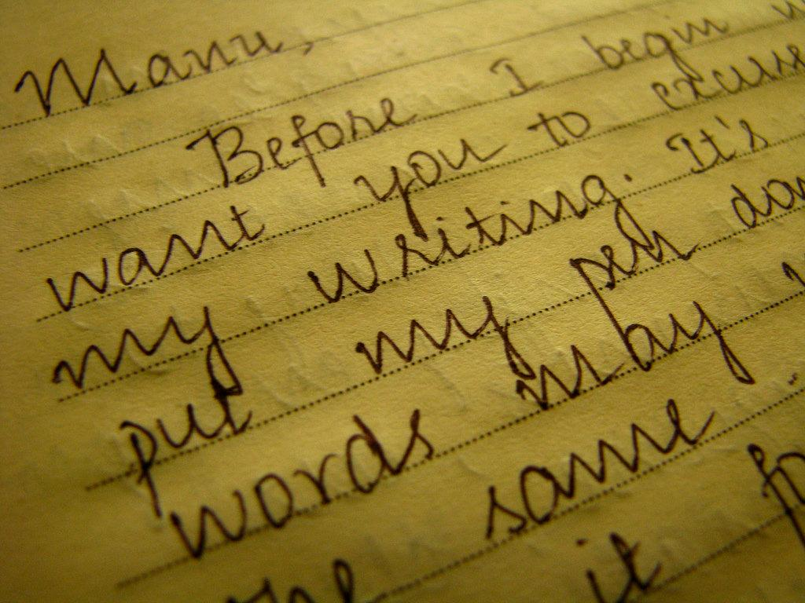
SUMMARIZE A TALK
a picture is worth a thousand words

Slide 6

ILLUSTRATE A BLOG POST
first thought, best thought

Slide 7
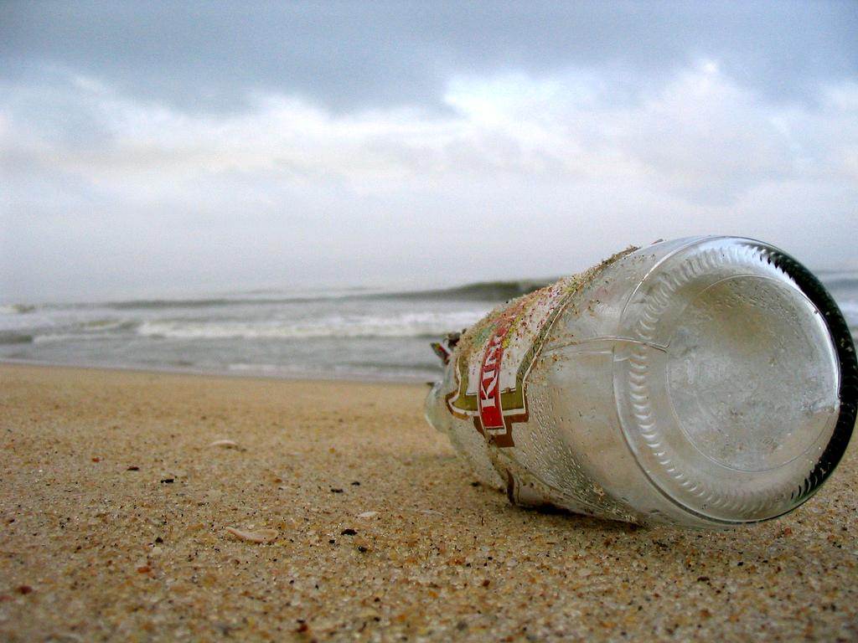
Send a message of thanks, redemption or congratulations.

Slide 8

SHARE A STORY
yours is amazing

Slide 9
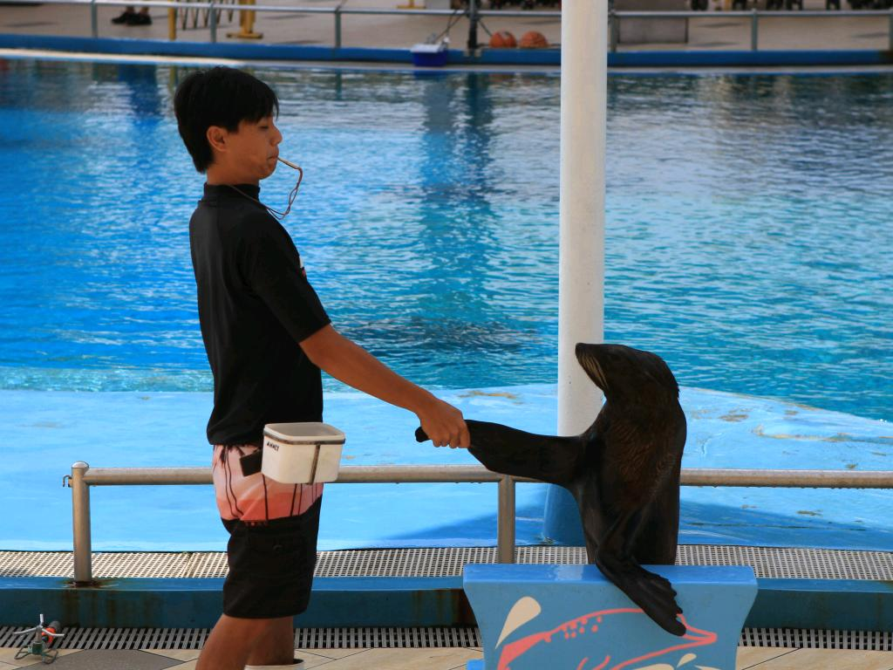
INTRODUCE YOURSELF
show your many talents

Slide 10

INSPIRE A GROUP
to climb a mountain, begin at the top

Slide 11

TEACH A LESSON
seed a thought, harvest a destiny

Slide 12

IGNITE A MOVEMENT
a jug fills drop by drop

